Slide 1
2016 Dream Team Conference Henry County Schools September 10, 2016
Beatrice Holmes
Math Instructional Lead Teacher
Stockbridge Elementary

Slide 2
During this session we will …
Practice strategies for math
Find digital resources for home support
Play grade-specific math games

Slide 3
Why is math so different from when I was in school?
Have you heard this before?
“I’m just not a math person.”

Slide 4
Without writing anything, try to solve this problem mentally:
500-298
What strategy did you use?

Slide 5
Students who are able to reason, understand and communicate their thinking develop Computational Fluency.
Computational Fluency means having methods that are…
flexible,
efficient,
and accurate
for computing.

Slide 7
456 + 167
How could your child solve this problem?

Slide 8
Fuson & Beckman, Standard Algorithms in the Common Core State Standards, NCSM Fall/Winter Journal, pgs. 14-30

Slide 9
Let’s use an open number line to solve 46 + 38.

Slide 10
46 + 38 Now try using base-ten blocks.

Slide 11
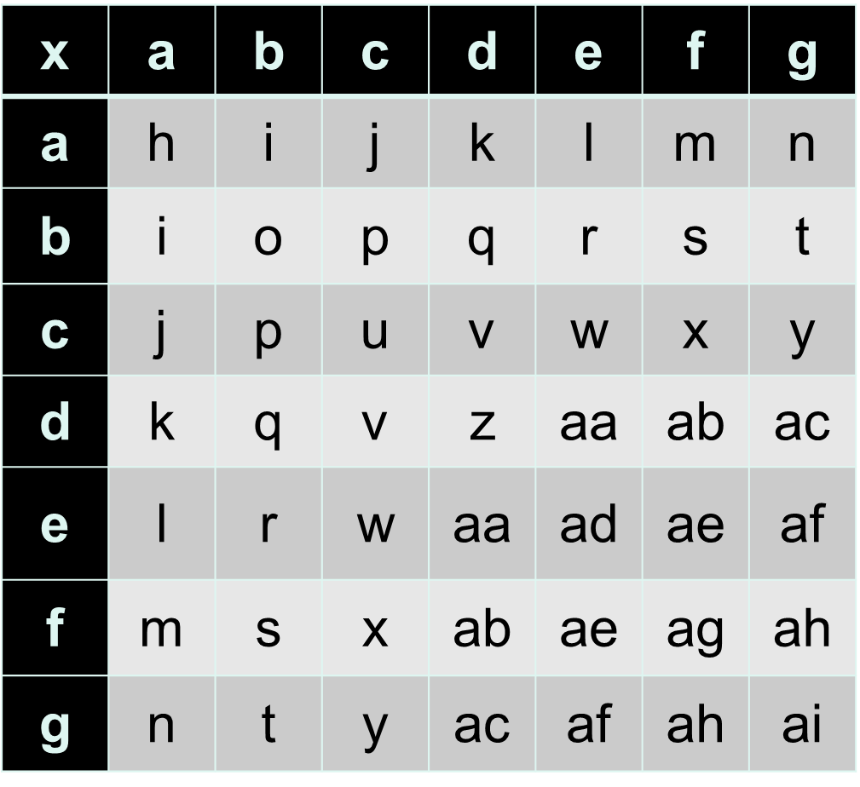
What about multiplication?
A student who is weak in number sense and doesn’t understand the relationship between numbers can make addition or multiplication drills to be as meaningless as this chart.

Slide 12
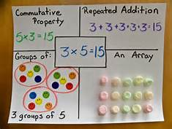
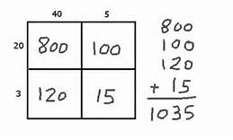
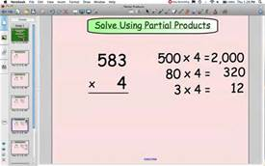
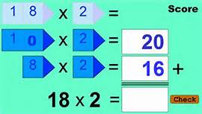

Slide 13
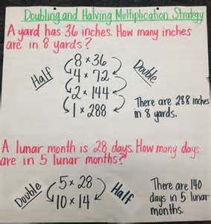
Try Doubling and Halving
4 x 12
25 x 6
8 x 7

Slide 14
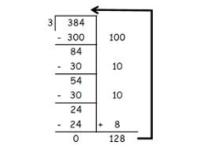
Partial Quotients
Multiplication Strategies
can support Division Strategies

Slide 15
Need some digital resources?
Visit my Parent Resource web page!

Slide 16
Let’s try some math games!

Slide 17
Thank you for coming today. Are there any questions?

